Slide 1


Introduction to Web Standards Principles of Web Design
Box Properties (CSS)

Slide 2
Objectives
Understand the CSS visual formatting model
Use the CSS box model
Apply the margin properties
Apply the padding properties
Apply the border properties
Use the page layout box properties
Create a simple page layout

Slide 3
The CSS Visual Formatting Model

Slide 4
The CSS Visual Formatting Model
Describes how the element content boxes should be displayed by the browser
Based on the hierarchical structure of the HTML document and element display type

Slide 5
The CSS Visual Formatting Model
Elements fall into three display type categories
Block (e.g., paragraphs): block elements contain inline boxes that contain element content
Inline: contain the content within the block-level elements; they do not form new blocks of content
List-item: create a surrounding containing box and list-item inline boxes

Slide 6
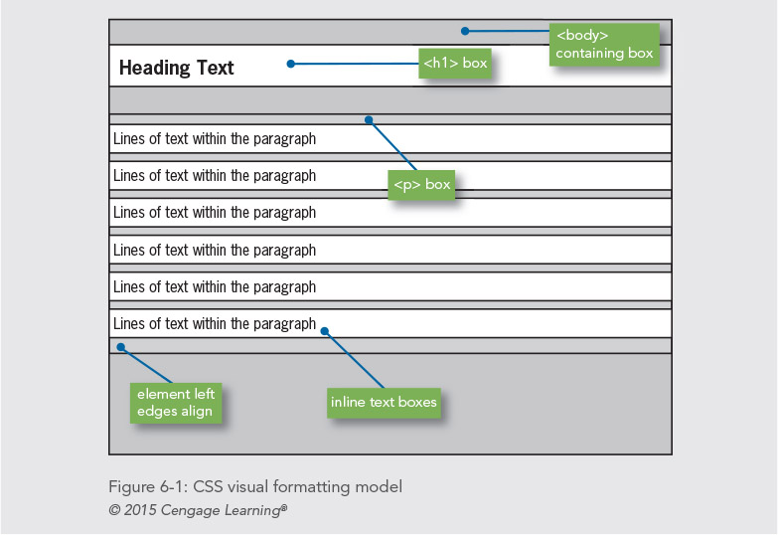

Slide 7
Specifying the Display Type
The CSS display property determines the display type of an element
You can create block-level, inline, and list type elements
The display property is often used to create horizontal navigation lists:
li {
display: inline;
list-style-type: none;
}

Slide 8
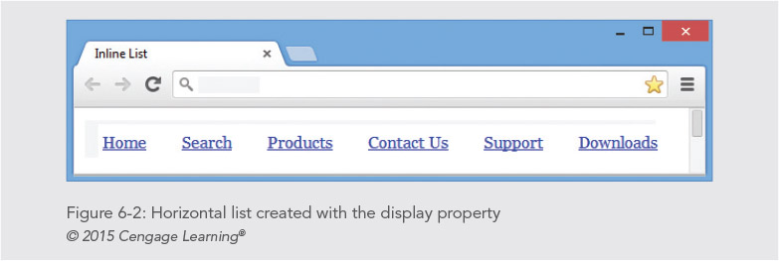

Slide 9
Using the CSS Box Model
Describes the rectangular boxes that contain content on a web page
Each block-level element created is displayed as a box containing content in the browser window
Each content box can have margins, borders, and padding (specified individually)

Slide 10
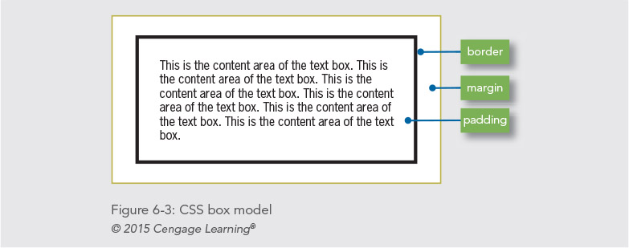

Slide 11
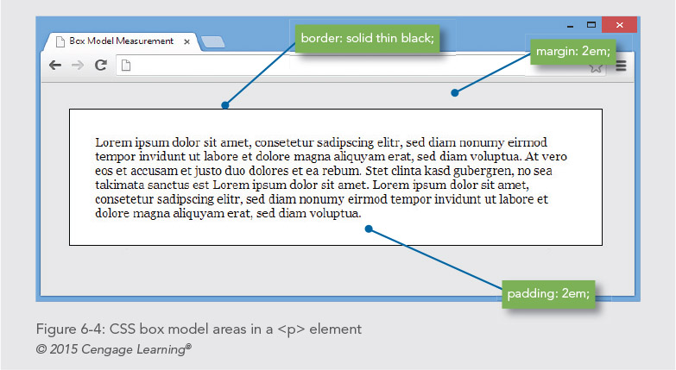

Slide 12
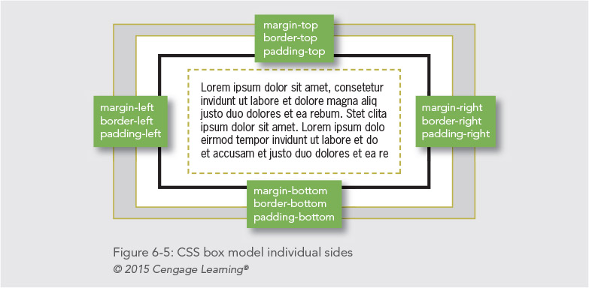

Slide 13
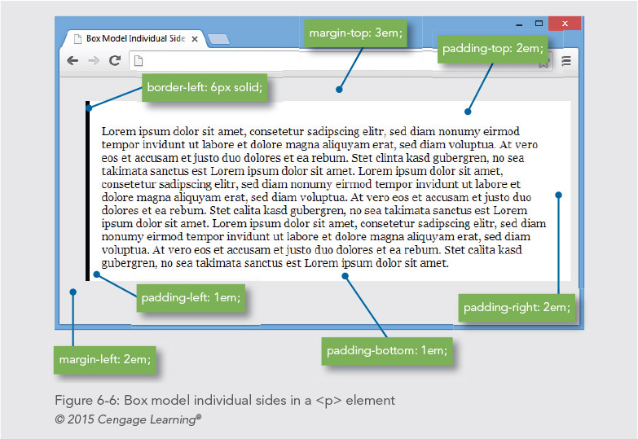

Slide 14
Box Model Individual Sides
Code for Figure 6-6:
p {
background-color: white;
margin-left: 2em;
margin-top: 3em;
border-left: 6px solid;
padding-top: 2em;
padding-right: 2em;
padding-bottom: 1em;
padding-left: 1em;
}

Slide 15
Measurement Values
The margin, border, and padding properties allow two types of measurement:
Length
Absolute or relative values
Percentage
Based on width of containing box

Slide 16
Applying the Margin Properties

Slide 17
Applying the Margin Properties
Margins are always transparent
Margins enhance the legibility of your text
You can specify either a length or percentage value
The following style rule sets all margins to 2 em
p {margin: 2em;}
You can specify settings for individual margins
p {
margin-left: 2em;
margin-right: 3em;
}

Slide 18
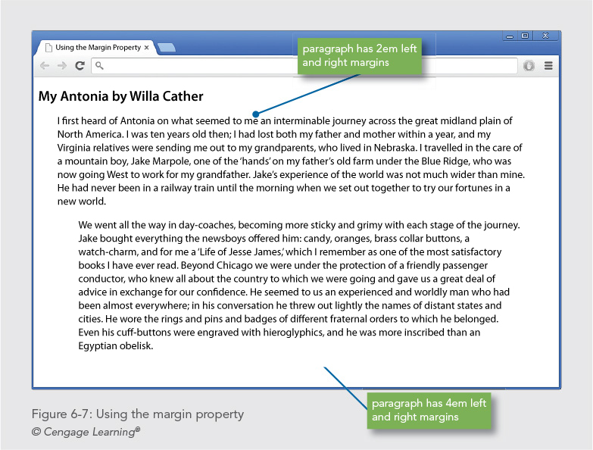

Slide 19
Negative Margins
Negative margins can be set to achieve special effects
You an override the default browser margin by setting a negative value
p {margin-left: -10px;}
Can also be used to remove the default margins from other elements

Slide 20
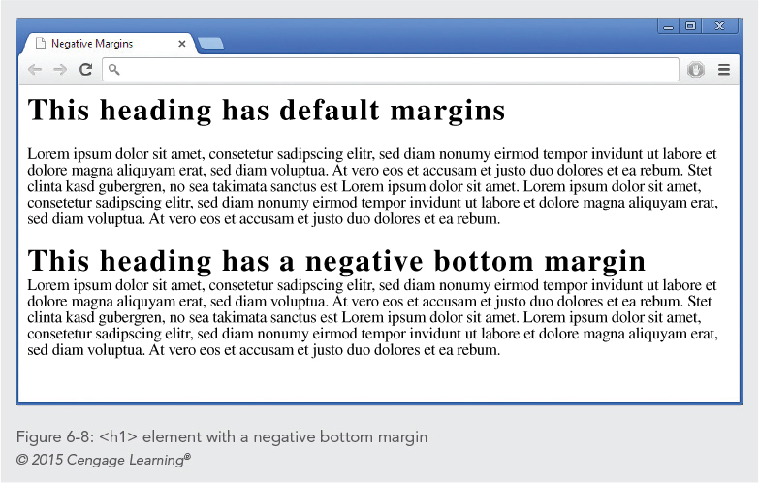

Slide 21
Collapsing Margins
To ensure spacing is consistent, the browser will collapse vertical margins between elements
By default, browser selects the greater of the two margins (top and bottom)

Slide 22
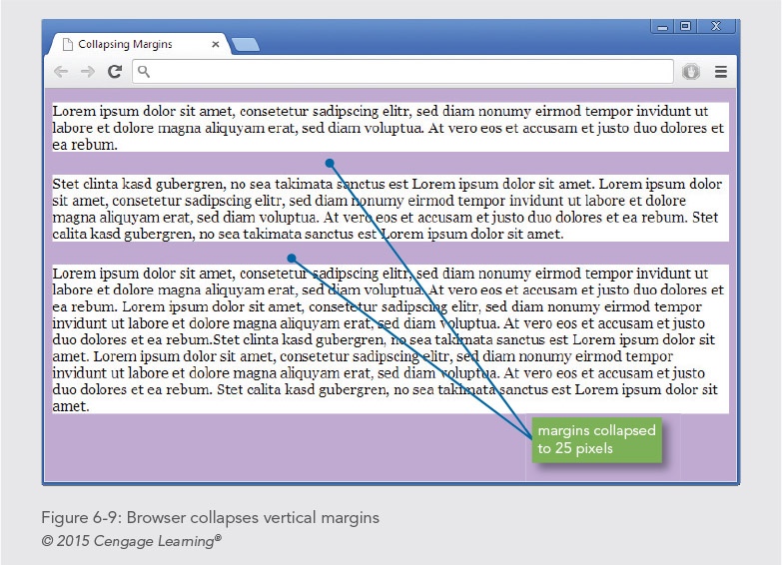

Slide 23
Zeroing Margins
To remove the default margin spacing in the browser, set margin values to zero
body {margin: 0; padding: 0;}
If you zero margins for the entire page, you must explicitly set margins for individual elements

Slide 24
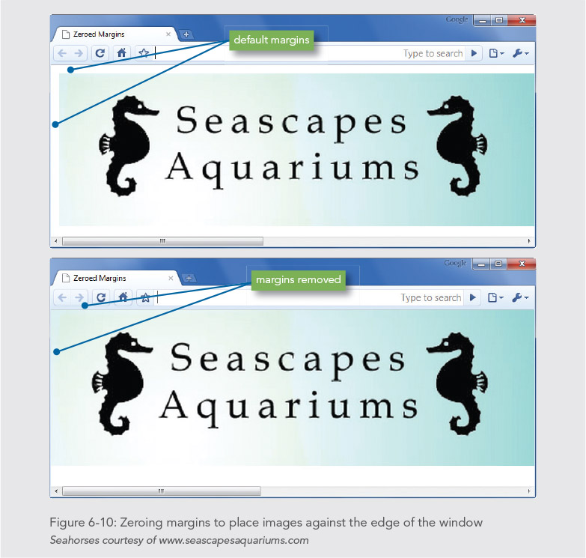

Slide 25
Applying the Padding Properties
Control the padding area in the box model
Area between the element content and the border
Padding area inherits the background color of the element
There are five padding properties:
padding
padding-top
padding-right
padding-bottom
padding-left

Slide 26
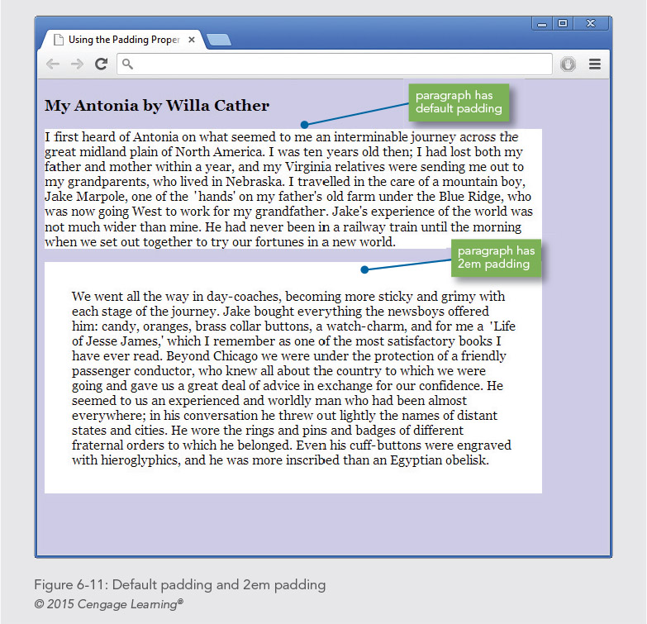

Slide 27
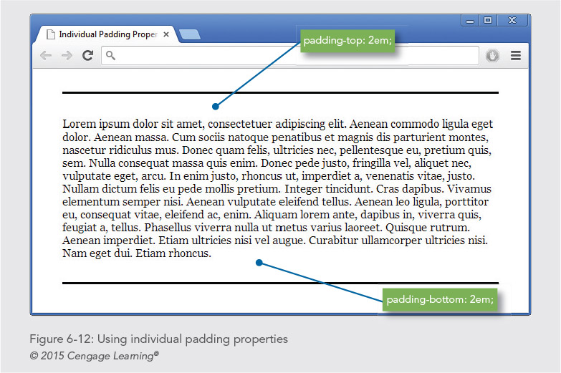

Slide 28
Applying the Padding Properties
Code for Figure 6-12:
p {
padding-top: 2em;
padding-bottom: 2em;
border-top: solid thin black;
border-bottom: solid thin black;
background-color: white;
margin: 2em;
}

Slide 29
Applying the Border Properties

Slide 30
Applying the Border Properties
Control the appearance of element borders
Border displays between the margin and the padding
There are five basic border properties:
border
border-top
border-right
border-bottom
border-left
A typical border style rule:
border {solid thin black}

Slide 31
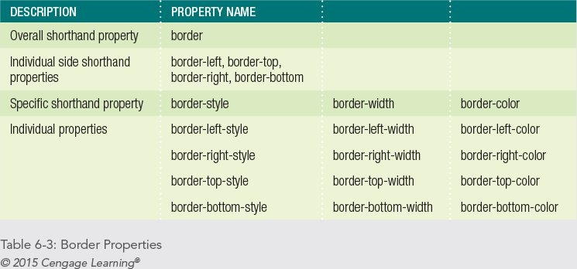

Slide 32
Specifying Border Style
Border style keywords:
none — no border on the element (default)
dotted — dotted border
dashed — dashed border
solid — solid line border
double — double line border
groove — 3D embossed border
ridge — 3D outward extended border
inset — 3D inset border (entire box)
outset — 3D outset (entire box)

Slide 33
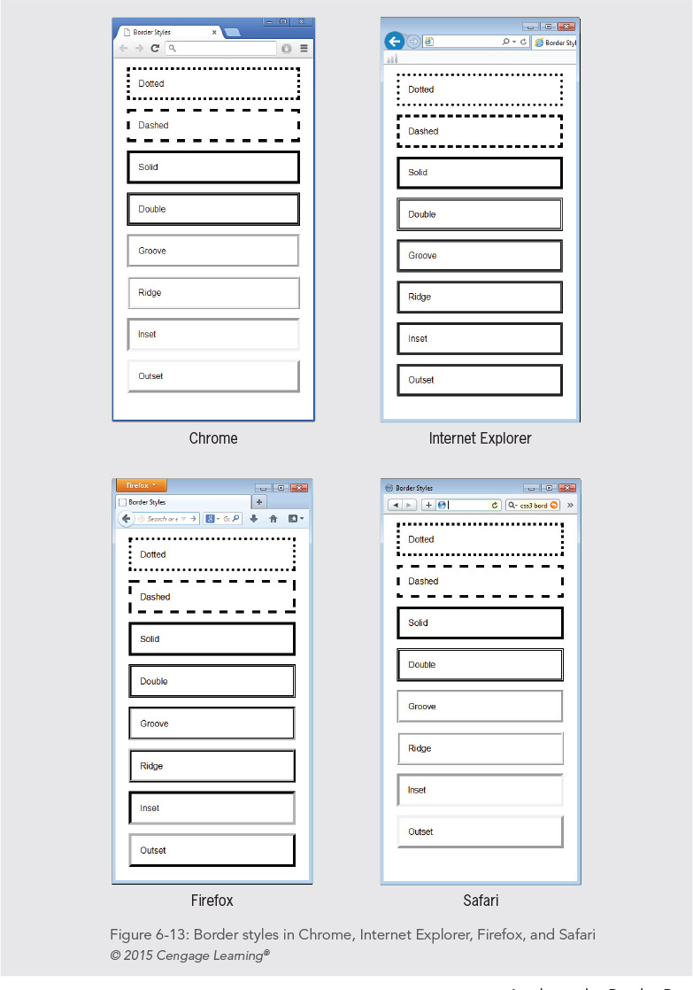

Slide 34
Specifying Border Width
Allows setting border width with either a keyword or a length value
You can use the following keywords to express width:
thin
medium (default)
thick

Slide 35
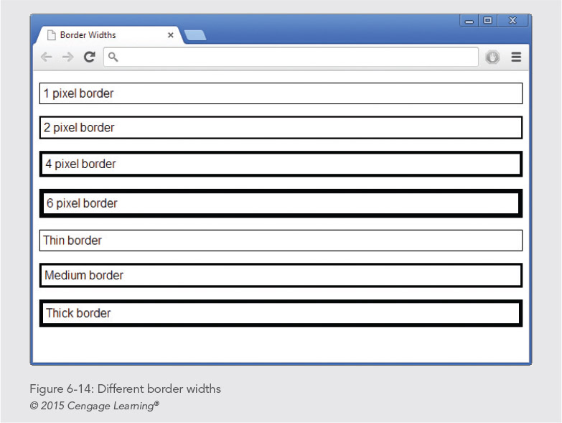

Slide 36
Specifying Border Color
The border color property lets you set the color of the element border
The value can be hexadecimal RGB or a color name

Slide 37
Using the Border Shorthand Syntax
The border property lets you state the properties for all four borders of an element
You can state the border-width, border-style, and border-color in any order
The following rule sets the border-style to solid
The border-weight is 1 pixel; the border color is red
p {border: solid 1px red;}

Slide 38
Specifying Rounded Borders
The CSS3 border radius property lets you create rounded borders
This property is supported by all modern browsers

Slide 39
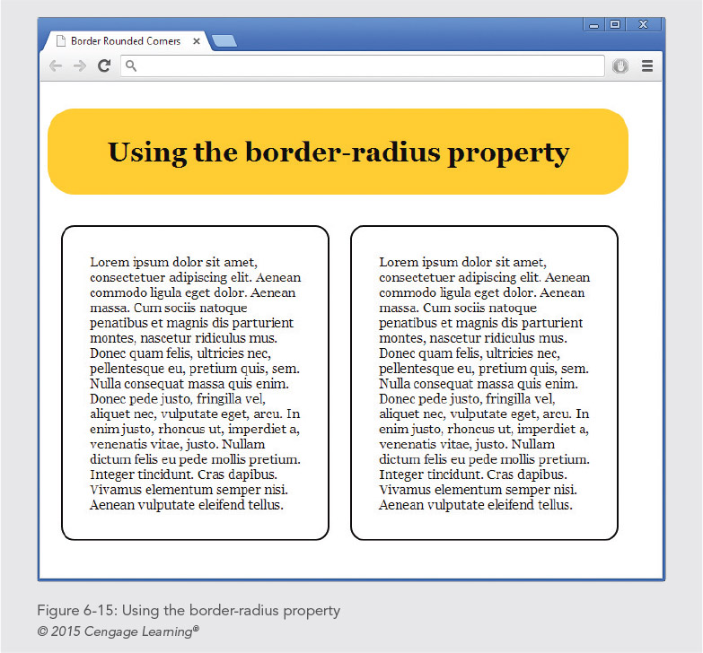
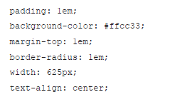

Slide 40
Specifying Individual Rounded Borders
You can use the individual properties to set each corner as show in Figure 6-16
You can use border-radius combined with other box model properties as shown in Figure 6-17

Slide 41
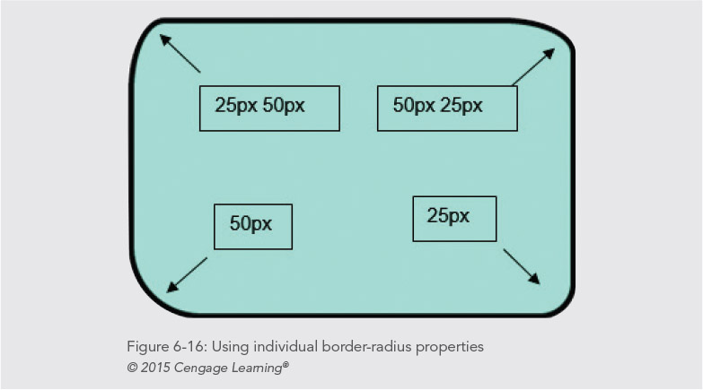

Slide 42
Specifying Individual Rounded Borders
Code for Figure 6-16:
border-top-left-radius: 25px 50px;
border-top-right-radius: 50px 25px;
border-bottom-left-radius: 50px;
border-bottom-right-radius: 25px;

Slide 43
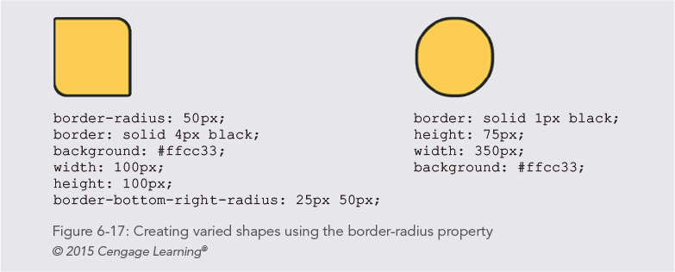
Specifying Individual Rounded Borders

Slide 44
Using the Page Layout Box Properties

Slide 45
Using the Page Layout Box Properties
These properties let you control the dimensions and position of content boxes
These properties are essential to building CSS page layouts
This section covers the following box properties
width, min-width, max-width
height, min-height, max-height
float
clear
overflow

Slide 46
Setting Element Width
Set
You can set the horizontal width of an element using either a length value or percentage
Use
For fixed layouts, use pixels
Use
For flexible layouts, use percentages

Slide 47
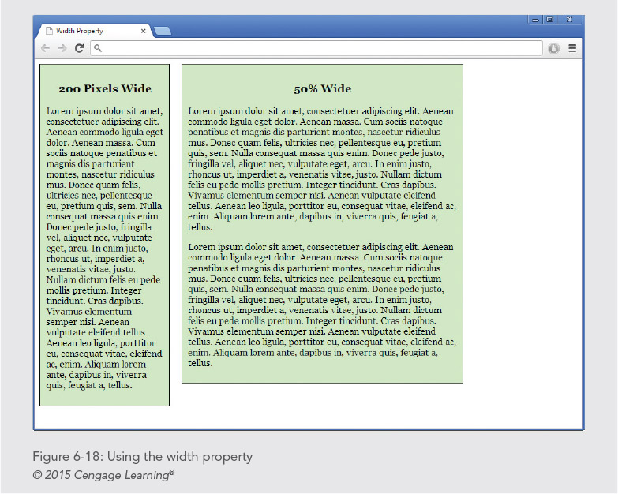

Slide 48
Calculating Box Model Width
The width you specify applies to the content only, not the entire element
The actual element width is the result of adding the padding border and margin to the content width

Slide 49
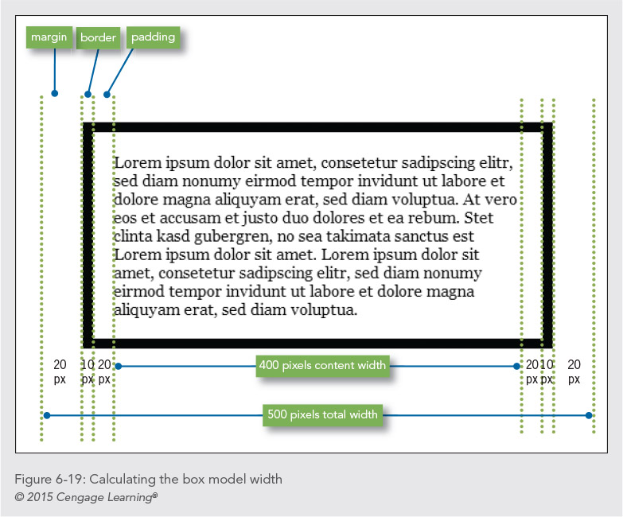

Slide 50
Setting Element Height
Height property lets you set the vertical height of an element
Normally the content should determine the height of the element
Height is useful when you need to create a box with specific dimensions
div {height: 150px; width: 300px;}

Slide 51
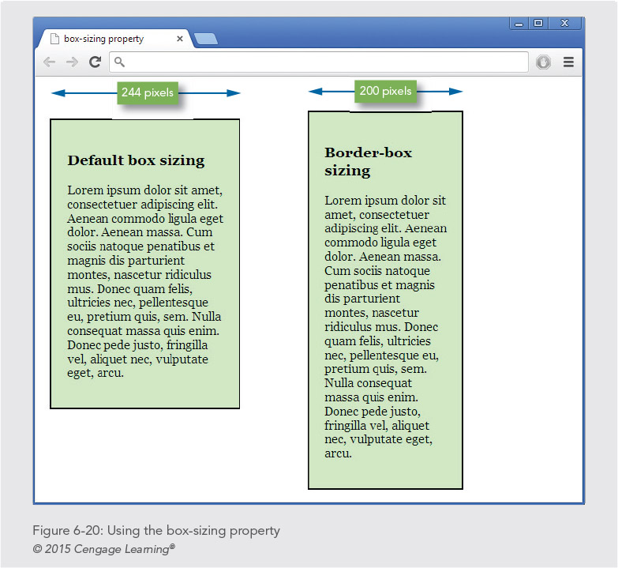

Slide 52
Floating Elements
The float property lets you position an element to the left or right edge of its containing element
You can float an image or content box to the left or right of text

Slide 53
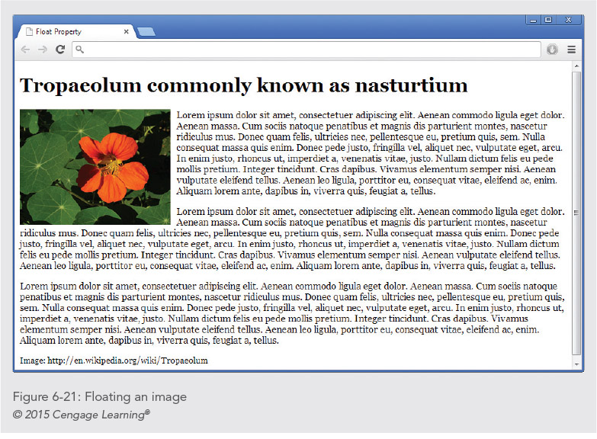
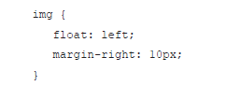

Slide 54
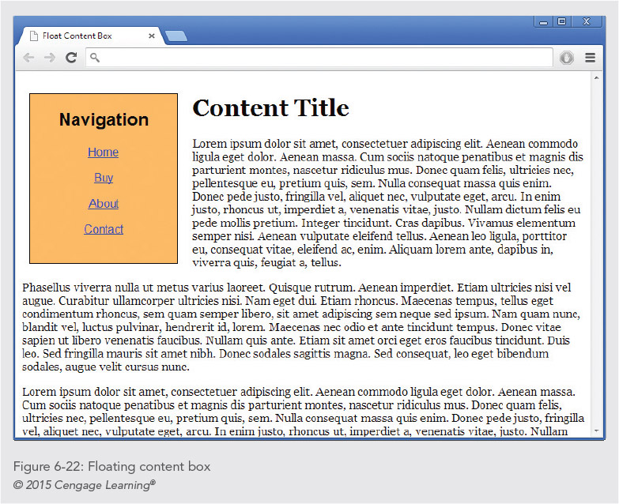
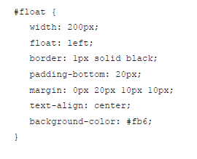

Slide 55
Floating Elements
#float {
width: 200px;
float: left;
border: 1px solid black;
padding-bottom: 20px;
margin: 0px 20px 10px 10px;
text-align: center;
background-color: #cfc;
}

Slide 56
Clearing Elements
The clear property lets you control the flow of text around floated elements
Clear is only used when you’re floating an element
Use the clear property to force text beneath a floated element rather than next to it

Slide 57
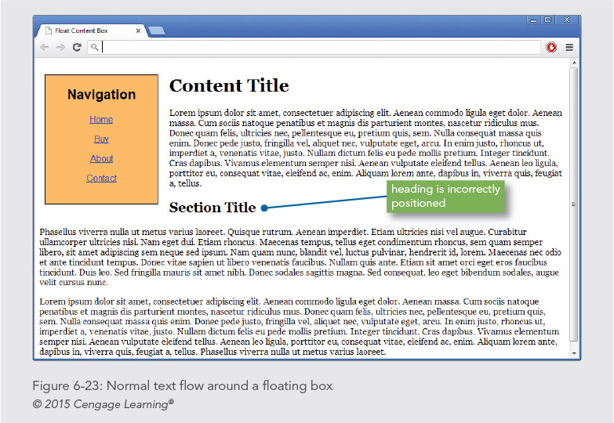

Slide 58
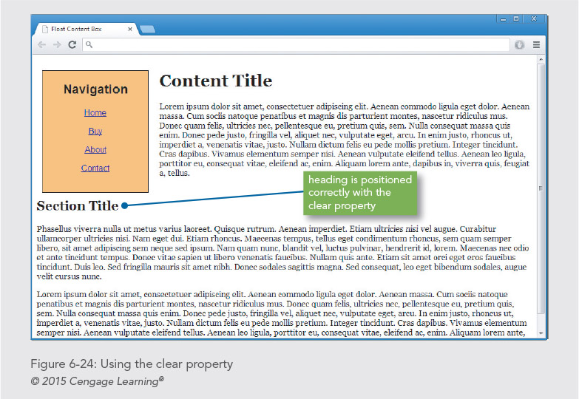
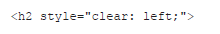

Slide 59
Controlling Overflow
The overflow property lets you control when content overflows the content box that contains it
This can happen when the content is larger than the area that contains it
Using the height property is the most common cause of overflow problems

Slide 60
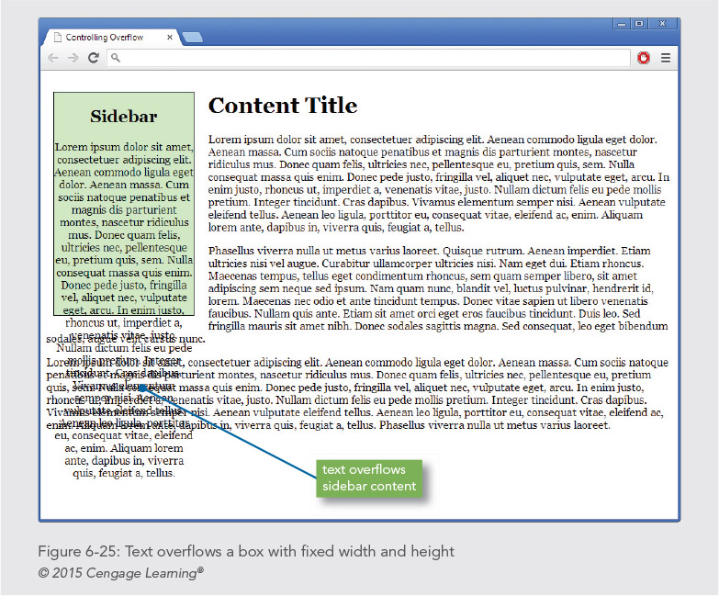

Slide 61
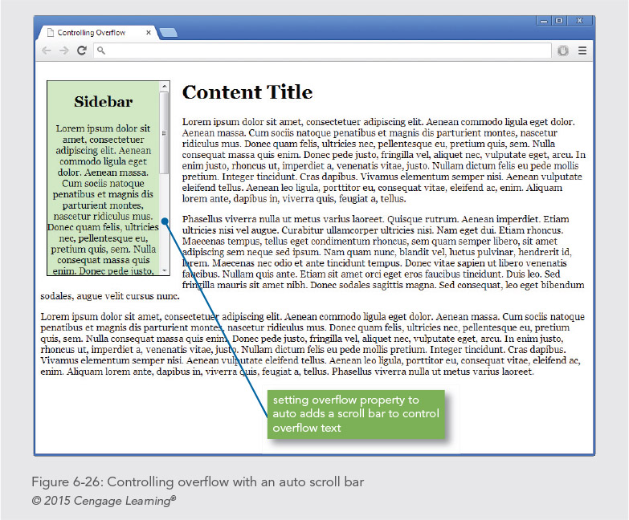

Slide 62
Creating Box Shadows
Box shadow property lets you add shadows to create a 3D effect
This is a CSS3 property that is not evenly supported by all browsers
You set both horizontal and vertical measurement and color for the shadowed edges of the box
p {
margin: 2em;
border: thin solid;
box-shadow: .5em .5em #ccc;
padding: 1em;

Slide 63
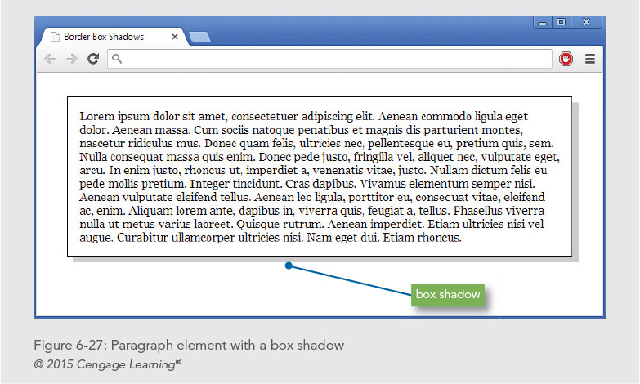

Slide 64
Creating Box Shadows
Code for Figure 6-27:
p {
margin: 2em;
border: thin solid;
box-shadow: .5em .5em #ccc;
padding: 1em;
}

Slide 65
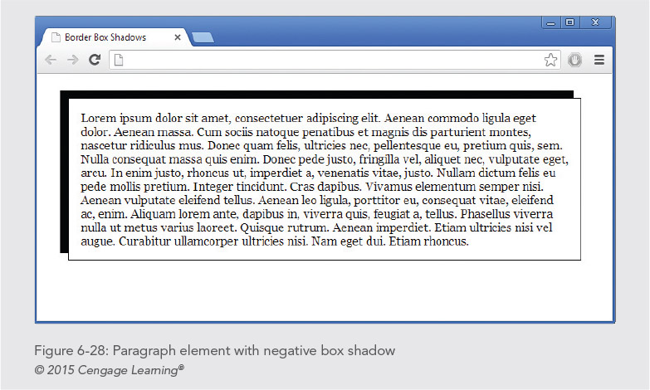

Slide 66
Creating Box Shadows
Code for Figure 6-28:
p {
margin: 2em;
border: thin solid;
box-shadow: -10px -10px #000;
padding: 1em;
}

Slide 67
Summary
The CSS box model lets you control spacing around elements
You can set margin, border and padding values for all four sides of the box
For flexible layouts, choose relative length units
For fixed pages, choose pixel measurements
The page layout box properties let you create floating content boxes and wrap text around images
Remember to use margin, border, and padding properties to enhance legibility

